Slide 1
混合可搜索加密方案设计
标准色
前后向安全
动态搜索
多场景适配

Slide 2
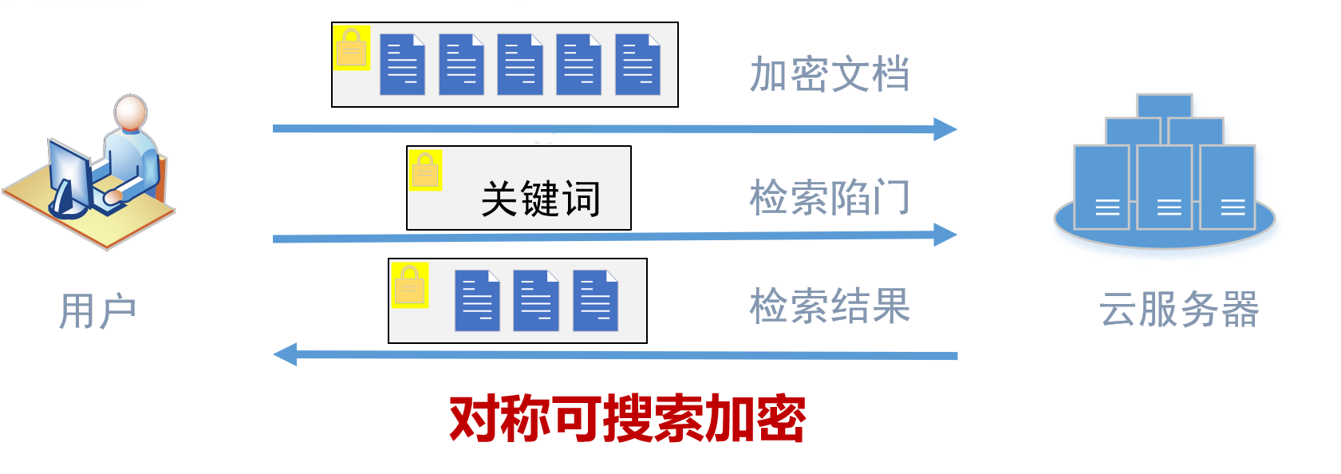
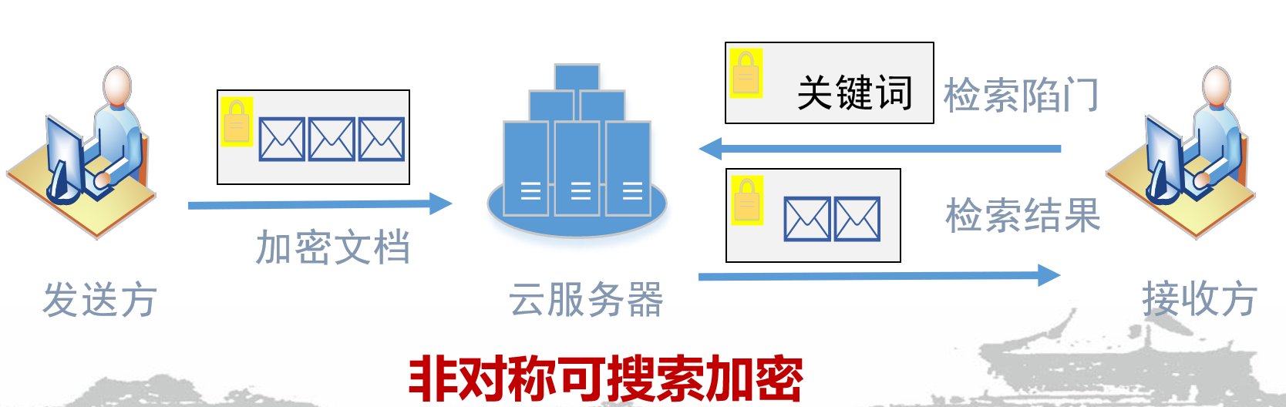
SSE与PKSE
Advantage: sublinear search(动态)
Shortcoming: not multi-writer
标准色
Multi-Client Cloud-Based Symmetric Searchable Encryption (TDSC 21)
Advantage: multi-writer
Shortcoming: requiring public-key operations linear in the database size
Lightweight Searchable Public-Key Encryption for Cloud-Assisted Wireless Sensor Networks (TII 18)

Slide 3
对称可搜索加密发展
静态文本数据
Searchable Symmetric Encryption: Improved Definitions and Efficient Constructions（JCS 06）
数据类型
动态文本数据（前向/后向）
Σoφoς – Forward Secure Searchable Encryption （CCS 16）
空间时间文本数据
When Geo-Text Meets Security: Privacy-Preserving Boolean Spatial Keyword Queries (ICDE 19)
单用户
UC-Secure Searchable Symmetric Encryption (FC 11)
用户模式
多用户
Multi-client Cloud-based Symmetric Searchable Encryption (TDSC 19)
单关键词（精确/模糊/通配符/词组）
VRFMS: Verifiable Ranked Fuzzy Multi-Keyword Search Over Encrypted Data (TSC 23)
检索模式
多关键词（合取/析取/布尔）
Boolean Searchable Symmetric Encryption with Worst-Case Sub-Linear Complexity (EUROCRYPT 17)
对称可搜索加密
（CCS 06）
SQL查询
Efficient Searchable Symmetric Encryption for Join Queries (AsiaCrypto 22)
私有验证
Towards efficient verifiable forward secure searchable symmetric encryption (ESORICS 19)
结果模式
公开可验证
Publicly verifiable searchable symmetric encryption based on efficient cryptographic components (DCC 19)
结果排序
Enabling Secure and Efficient Ranked Keyword Search over Outsourced Cloud Data (TPDS 11)
搜索模式
SAP-SSE: Protecting Search Patterns and Access Patterns in Searchable Symmetric Encryption (TIFS 21)
安全属性
访问模式
New Constructions for Forward and Backward Private Symmetric Searchable Encryption (CCS 18)
体积模式
Practical Volume-Hiding Encrypted Multi-Maps with Optimal Overhead and Beyond(CCS 22)

Slide 4
公钥可搜索加密发展
静态文本数据
Server-Aided Public Key Encryption With Keyword Search （TIFS 16）
数据类型
动态文本数据（前向/后向）
Forward Secure Public Key Encryption with Keyword Search for Outsourced Cloud Storage （TCC 22）
空间时间文本数据
Geometric Searchable Encryption for Privacy-Preserving Location-Based Services（TSC23）
身份加密
Searchable Encryption Revisited: Consistency Properties, Relation to Anonymous IBE, and Extensions （JoC 08）
属性加密
FEASE: Fast and Expressive Asymmetric Searchable Encryption （Usenix security 24）
密码工具
无证书加密
Certificateless Searchable Public Key Encryption Scheme for Industrial Internet of Things（TII 17）
函数加密（内积）
Dynamic Symmetric Searchable Encryption from Constrained Functional Encryption （CT-RSA16）
公钥可搜索加密
（EUROCRYPT 04）
抗量子加密
QPASE: Quantum-Resistant Password-Authenticated Searchable Encryption for Cloud Storage（TIFS24）
单关键词
Encapsulated Search Index: Public-Key, Sub-linear, Distributed, and Delegatable （PKC 22）
检索模式
多关键词
Multi-client Sub-Linear Boolean Keyword Searching for Encrypted Cloud Storage with Owner-enforced Authorization （TDSC 22）
结果可验证
Optimized Verifiable Fine-Grained Keyword Search in Dynamic Multi-owner Settings （TDSC 19）
结果模式
结果可排序
Attribute-Based Expressive and Ranked Keyword Search over Encrypted Documents in Cloud Computing （TSC 22）
安全属性(抗关键词猜测攻击)
DEKS: A Secure Cloud-Based Searchable Service Can Make Attackers Pay （ESORICS 2022）

Slide 5
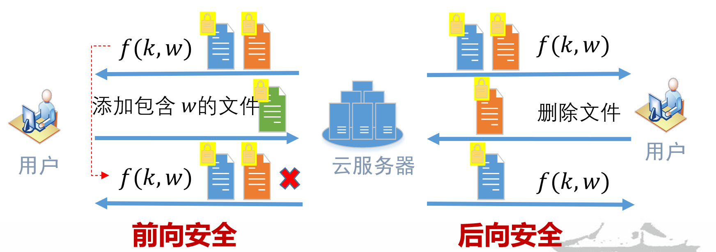
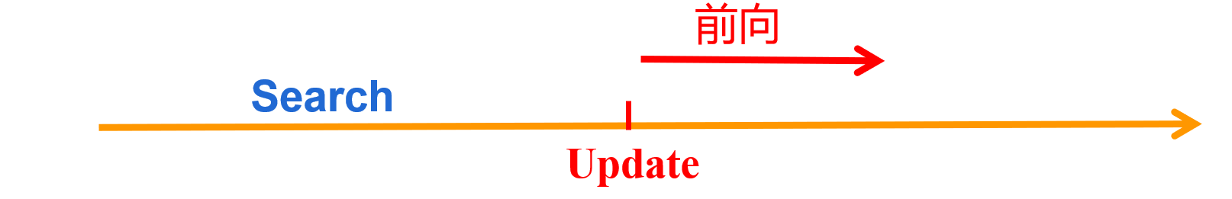
前向安全
标准色
An update does not leak any information about the updated keywords. In particular, the server cannot learn that an updated document matches a keyword we previously queried.
Previous search trapdoors cannot match trapdoors of updated files.

Slide 6
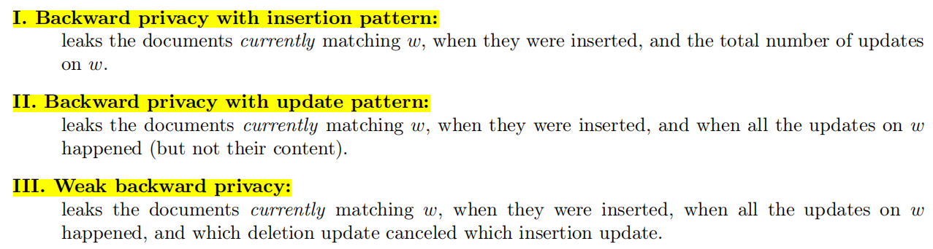
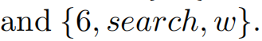
后向安全
An SSE scheme is backward-secure if, whenever a keyword/document pair (w,ind) is added into the database and then deleted, subsequent Search queries on w do not reveal ind.
Update trapdoors cannot match trapdoors of deleted files.
后向
Delete
Update

Slide 7
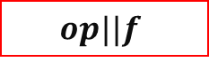

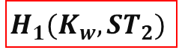

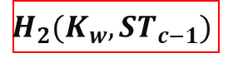
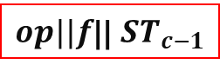


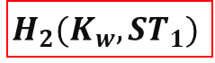
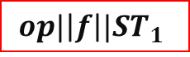
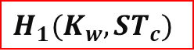
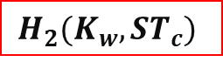

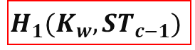
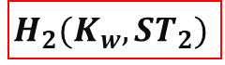

前向安全方案一般构造
Update
$$H_{1}(K_{w},{ST}_{1})$$
$$H_{1}(K_{w},{ST}_{2})$$
$$H_{1}(K_{w},{ST}_{c−1})$$
$$H_{1}(K_{w},{ST}_{c})$$
$$H_{2}(K_{w},{ST}_{1})$$
$$H_{2}(K_{w},{ST}_{2})$$
$$H_{2}(K_{w},{ST}_{c−1})$$
$$H_{2}(K_{w},{ST}_{c})$$
$$⊕$$
$$⊕$$
$$⊕$$
$$⊕$$
$$op||f$$
$$op|\left|f\right||{ST}_{1}$$
$op||f$|| ${ST}_{c−2}$
$op||f$|| ${ST}_{c−1}$
Search
Dynamic Searchable Encryption with Optimal Search in the Presence of Deletions （Usenix security 22）
ROSE: Robust searchable encryption with forward and backward security （TIFS 22）

Slide 8
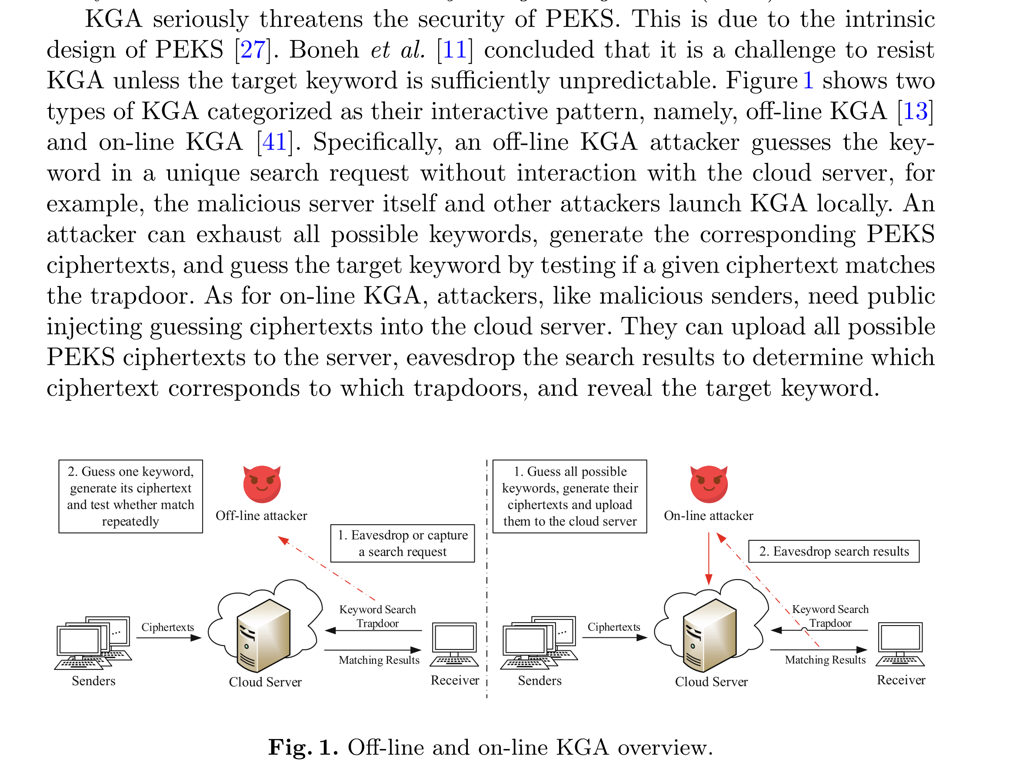
关键词猜测攻击

Slide 9
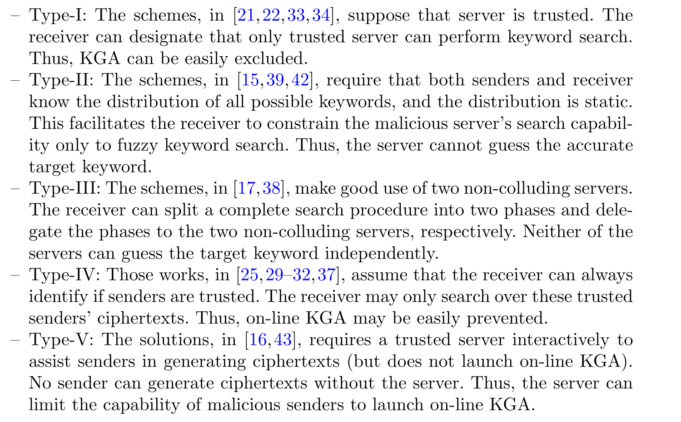
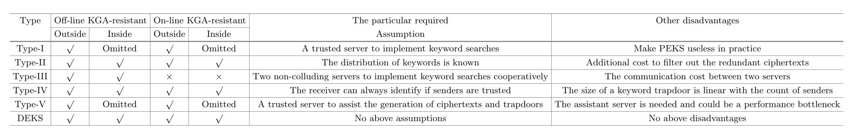
抗关键词猜测攻击一般构造

Slide 10
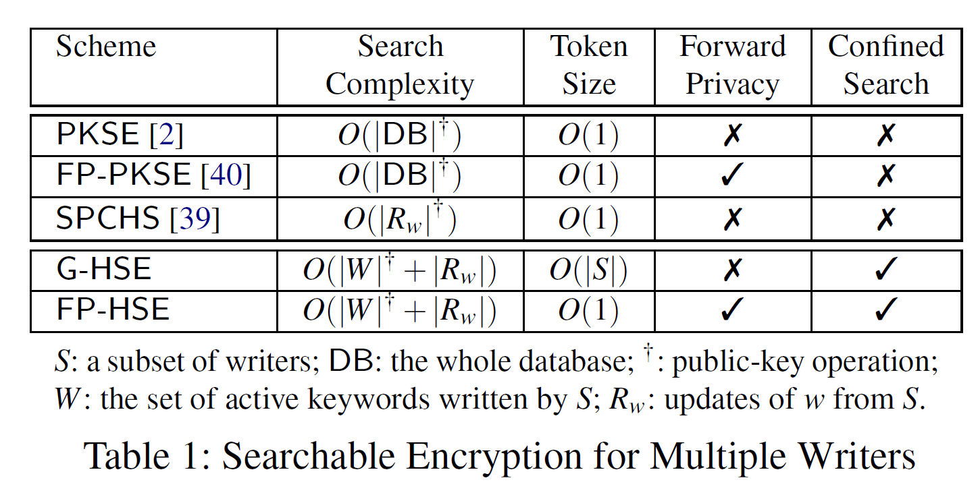
Contributions
Omnes pro uno: Practical Multi-Writer Encrypted Database
USENIX Security 22
Jiafan Wang, Sherman S. M. Chow
New Paradigm of Searchable Encryption (HSE): DSSE+IBE
New Primitive: ID-Coupling Key-Aggregate Encryption
New Epoch-Based Forward Privacy
Forward-Private HSE with Compact Tokens
标准色
04
Notes:
对称可搜索加密中的非线性搜索与公钥可搜索加密中的多写入者。

Slide 11
设计目标
No Secret-Key Distribution: HSE writers should only use the public key of the reader to create HSE ciphertexts.
No Synchronous Communication: Communication rounds, an important criterion of searchable encryption , should be kept minimal.
Optimal Asymmetric and Symmetric Efficiency: HSE writers can independently (public-key) encrypt their updates for the exact or different keywords. HSE still keeps the number of symmetric operations sublinear as optimal SSE.
Compact Token for Confined Search: HSE can restrict the scope of each search to a different writer subset.
Forward Privacy: Search authorized over an old database contributed by some writers should not automatically compromise the data privacy of the future data submitted by other honest writers.
06

Slide 12
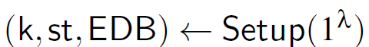
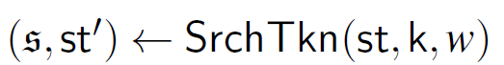
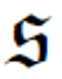
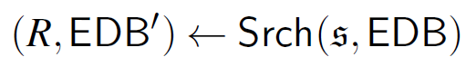
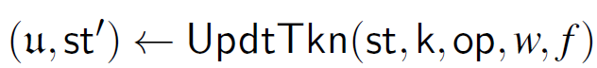
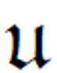
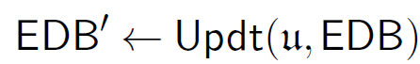
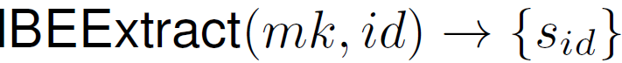
DSSE
Server (curious)
Client (honst)
Step 1:
EDB
Step 2:
R
Step 3:
Step 4:
Step 5:
Step 1:
Step 2:
Step 3:
Step 4:
IBE

Slide 13
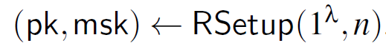
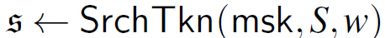
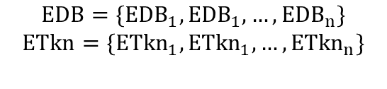
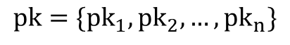

G-HSE
Step 4:
Step 6:
Server
$$EDB=\{{EDB}_{1},{EDB}_{1},…,{EDB}_{n}\}$$
$$ETkn=\{{ETkn}_{1},{ETkn}_{1},…,{ETkn}_{n}\}$$
R
$$pk=\{{pk}_{1},{pk}_{2},…,{pk}_{n}\}$$
$n$Writers
Reader
Step 2:
Step 1:
Step 5:
Step 3:

Slide 14
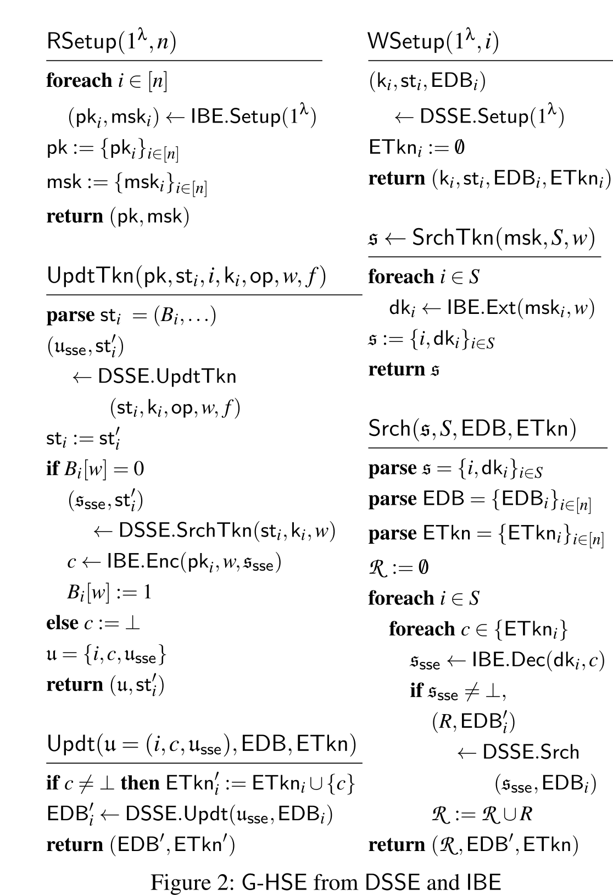
G-HSE
Reader
Writers
Reader
Writers
Server
The number of search tokens is linear in the writer-subset size
Forward privacy as the search tokens never change
Server
07

Slide 15
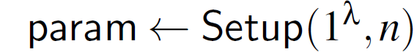
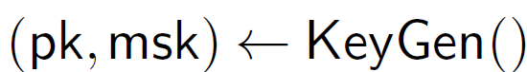
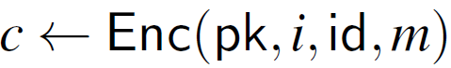
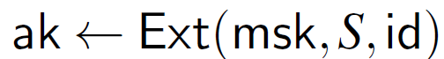
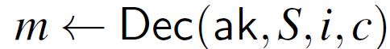
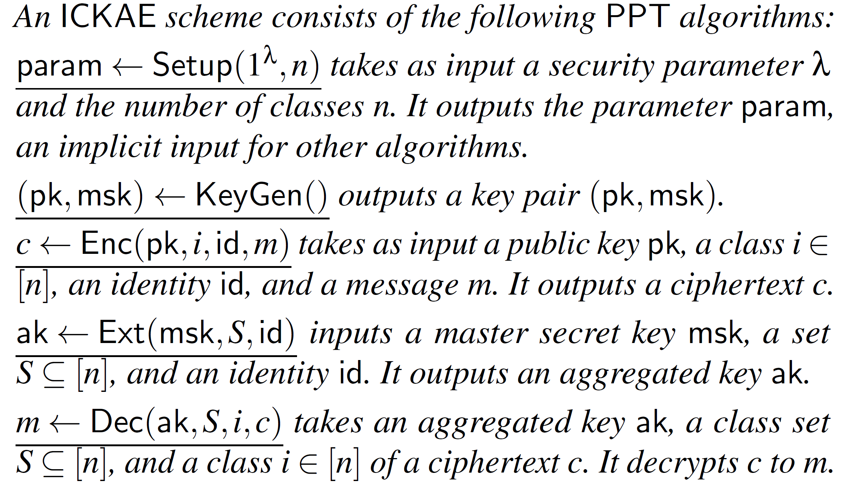
ICKAE
Step 1:
Step 2:
Step 3:
Step 4:
Step 5:
ICKAE
Correctness
Compactness
Confidentiality and Anonymity
08

Slide 16
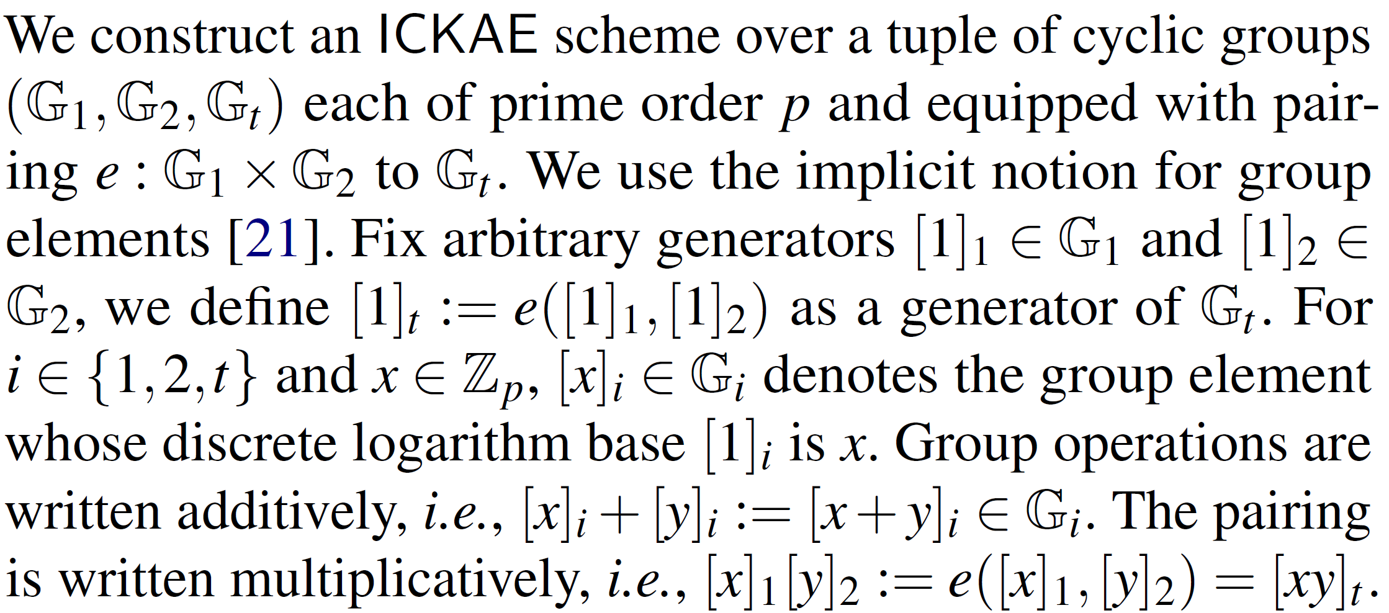
ICKAE
Cheng-Kang Chu, Sherman S. M. Chow, Wen-Guey Tzeng, Jianying Zhou, and Robert H. Deng. Key-aggregate cryptosystem for scalable data sharing in cloud storage. IEEE Trans. Para. Dis. Sys., 25(2):468– 477, 2014.

Slide 17
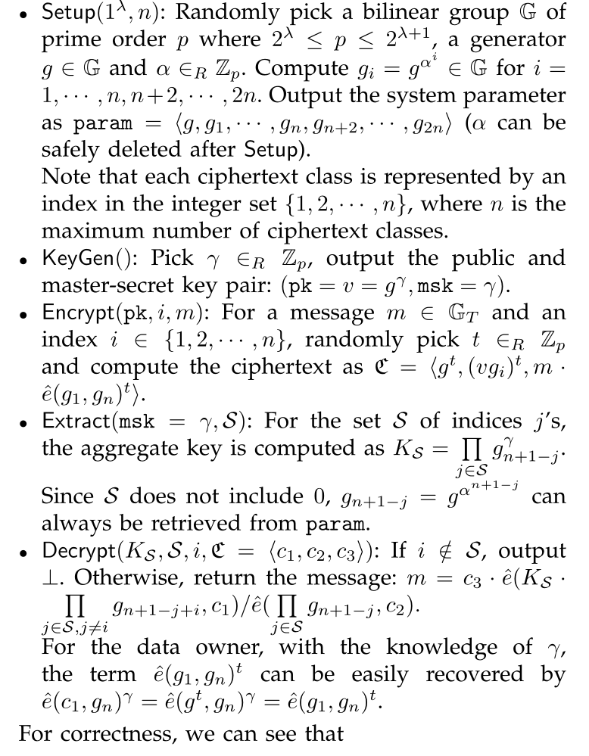
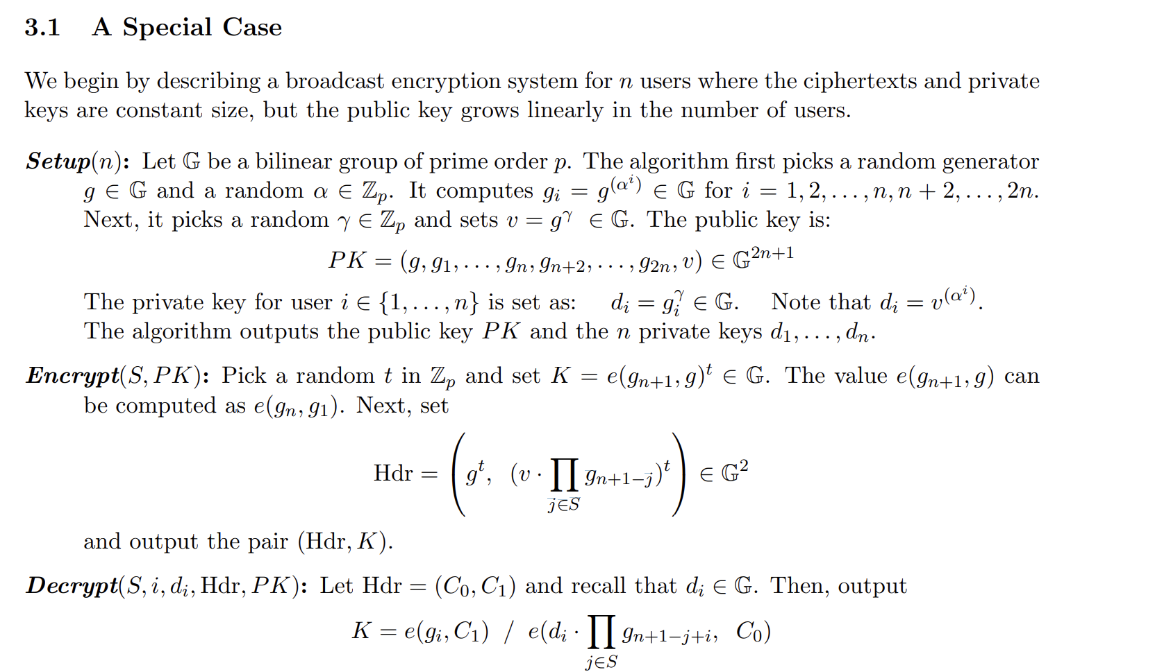
ICKAE
09

Slide 18
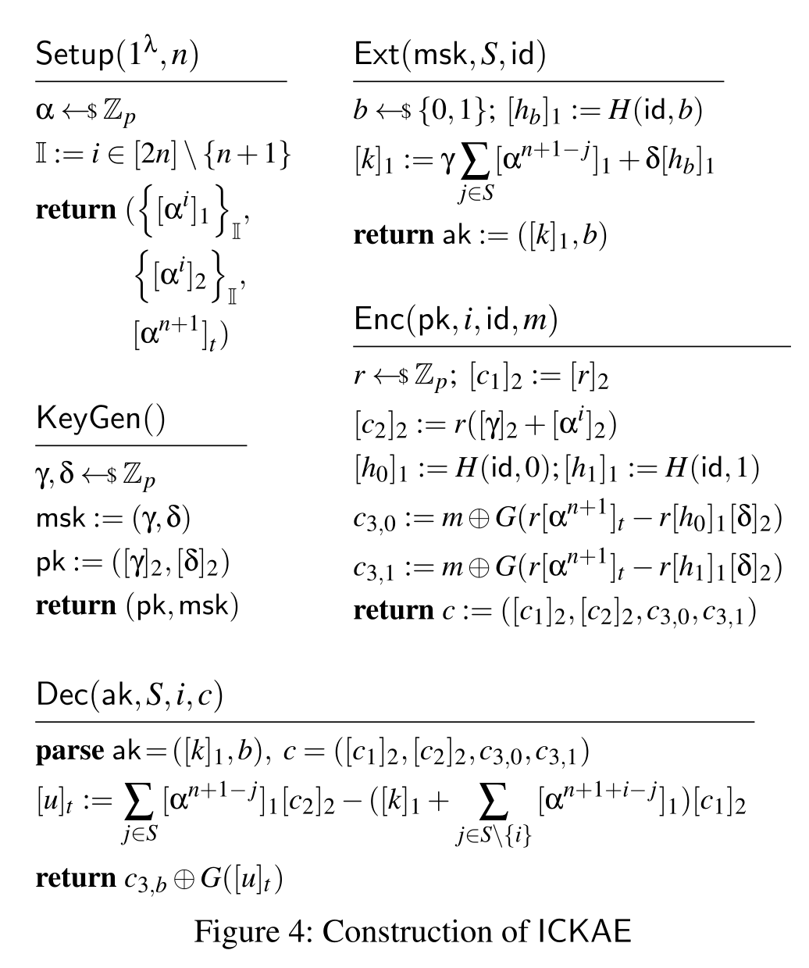
ICKAE

Slide 19

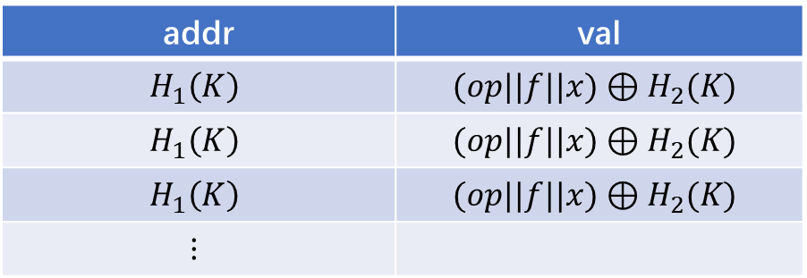
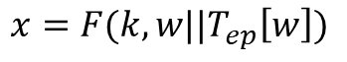
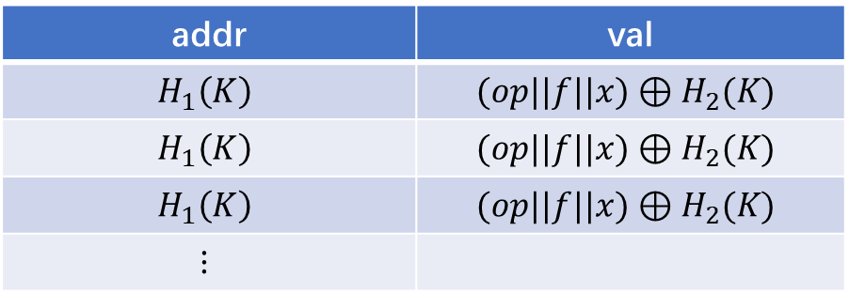



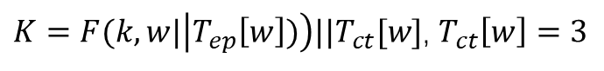
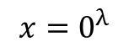
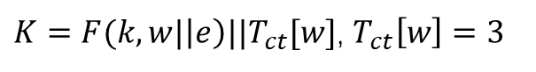
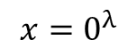







E-DSSE
Epoch-Based Forward-Private DSSE
addr | val
$$H_{1}\left(K\right)$$ | $$(op||f||x)⊕H_{2}(K)$$
$$H_{1}\left(K\right)$$ | $$(op||f||x)⊕H_{2}(K)$$
$$H_{1}\left(K\right)$$ | $$(op||f||x)⊕H_{2}(K)$$
$$⋮$$
$K=F(k,w|\left|e\right)||T_{ct}[w]$, $T_{ct}\left[w\right]=1$
$x=$ $F(k,w||T_{ep}\left[w\right])$
$$K=F(k,w|\left|e\right)||T_{ct}[w]\text{, }T_{ct}\left[w\right]=2$$
$$x=0^{λ}$$
$K=F(k,w|\left|e\right)||T_{ct}[w]$, $T_{ct}\left[w\right]=3$
$$x=0^{λ}$$
$$⋮$$
$$⋮$$
$$⋮$$
addr | val
$$H_{1}\left(K\right)$$ | $$(op||f||x)⊕H_{2}(K)$$
$$H_{1}\left(K\right)$$ | $$(op||f||x)⊕H_{2}(K)$$
$$H_{1}\left(K\right)$$ | $$(op||f||x)⊕H_{2}(K)$$
$$⋮$$
$K=F(k,w|\left|T_{ep}\left[w\right])\right)||T_{ct}[w]$, $T_{ct}\left[w\right]=1$
$x=$ $F(k,w||T_{ep}\left[w\right])$
$$K=F(k,w|\left|T_{ep}\left[w\right])\right)||T_{ct}[w]\text{, }T_{ct}\left[w\right]=2$$
$$x=0^{λ}$$
$K=F(k,w|\left|T_{ep}\left[w\right])\right)||T_{ct}[w]$, $T_{ct}\left[w\right]=3$
$$x=0^{λ}$$
$$⋮$$
$$⋮$$

Slide 20


E-DSSE
标准色
11

Slide 21

FP_HSE
标准色
12

Slide 22

Unus pro omnibus: Multi-Client Searchable Encryption via Access Control
NDSS 24
Jiafan Wang, Sherman S. M. Chow

Slide 23


应用场景
sublinear searches, standard forward privacy, and multi-client support
应用场景
程序员拥有读写权限，允许他们写入源代码和审查日志。
审计人员可能拥有只读访问，但可以在查看后写入日志

Slide 24


安全性要求
DSE 对手不仅可以破坏服务器，还可以破坏许多拥有不同关键字搜索或更新权限的客户端
完整性以捕捉保证诚实客户端的更新始终可以被授权者搜索，即使恶意客户端试图破坏加密数据库

Slide 25




IBE

Slide 26



SME

Slide 27


算法流程

Slide 28



委托

Slide 29


更新

Slide 30

搜索

Slide 31




完整性证明

Slide 32
标准色

